Slide 1
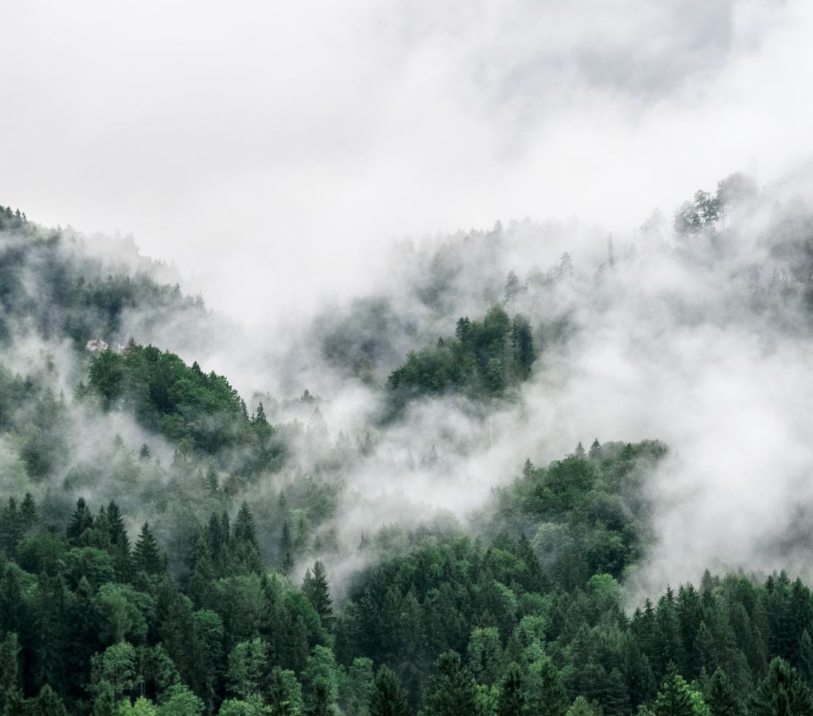
Charlotte Parks & Recreation

Slide 2
Background
We’re a team of émigrés to Charlotte and we wanted to use this project to get to know our adopted city a little better. We decided to explore Charlotte Parks and Recreation because of our mutual love for green spaces. We wanted to understand the availability to parks in different areas of Charlotte, what those parks are used for (walking, biking, picnicking, etc.), whether there is a correlation between park access and affluency, and what recreational events are available to the public.

Slide 3
Data & Databases
Data:
Data was obtained through data.charlotte.gov, specifically the Parks file. To obtain the population, we identified a file from zipatlas.com, which included the population of the Charlotte Metro region by zip code.
Regarding the population data – the most recent information on this site was from 2010. Although population grew by just over 20%, we opted to keep the data true to the source. Information from these sites was extracted by downloading to csv files.
Additionally, the Mecklenburg County Parks and Recreation website was utilized to scrape their spring activity list.
Database Connection:
The team utilized Python/Pandas to pull in the 2 data sources. Cleansing was performed to merge the data into 1 dataframe through matching on zip code. Several fields contained no data or not aligned to our analysis. This data was removed from our dataframe. To meet project requirements, the python dataframes were transfered to a databases, all data headings needed to be renamed before loading to Postgres.
In the end our parks_db included 3 tables. The parks table was created based upon the combination of parks information from Charlotte.gov and the zipatlas.com data as information within each record was closely related.
The events table was used to capture key events obtained through web-scraping.
The zipcode-coord table was created based upon data obtained from the geoJson. Within the database - the zipcode and parks tables can be connected by zipcode now that a look up for each coordinate was completed (use of https://www.geocod.io/upload/). This site was also used to lookup and pinpoint the coordinate location for each of the parks (by using address).

Slide 4
Flask API, HTML/CSS & Javascript, Heroku
Flask API:
Utilizing Flask, we were able to connect to the databases to assist in visual creation. The Flask API connection also served as the landing page from which the visualizations and data analysis can be viewed and interacted with by the user.
A separate app.py file was created to facilitate the flask build-out. This included importing dependencies to connect to our SQL databases and then loop through the databases ultimately creating dictionaries from which the data could be pulled by other team members to leverage in visualization creation.
HTML/CSS & Javascript:
The initial HTML/CSS code was built as a shell with place hoders linked to Javascript files for team members to build out their visualizations and apply consistent formatting and sizing using Bootstrap. As the project advanced, the html/css styling was updated to ensure appropriate svg image sizing as the separate javascript visualization files were completed. Additionally, the html file was leveraged to incorporate analysis in paragraph form for each visualization. It was also used to mitigate challenges with Flask alignment. The website invites user interaction via a drop-down menu which toggles between different visualizations. This is divided into a home page containing geomapping visualizations, a page reflecting a bar chart visualization, and a third reflecting a table constructed from scraped data.
Heroku:
The website is now hosted on a Heroku app at: https://charlotte-parks.herokuapp.com/

Slide 5
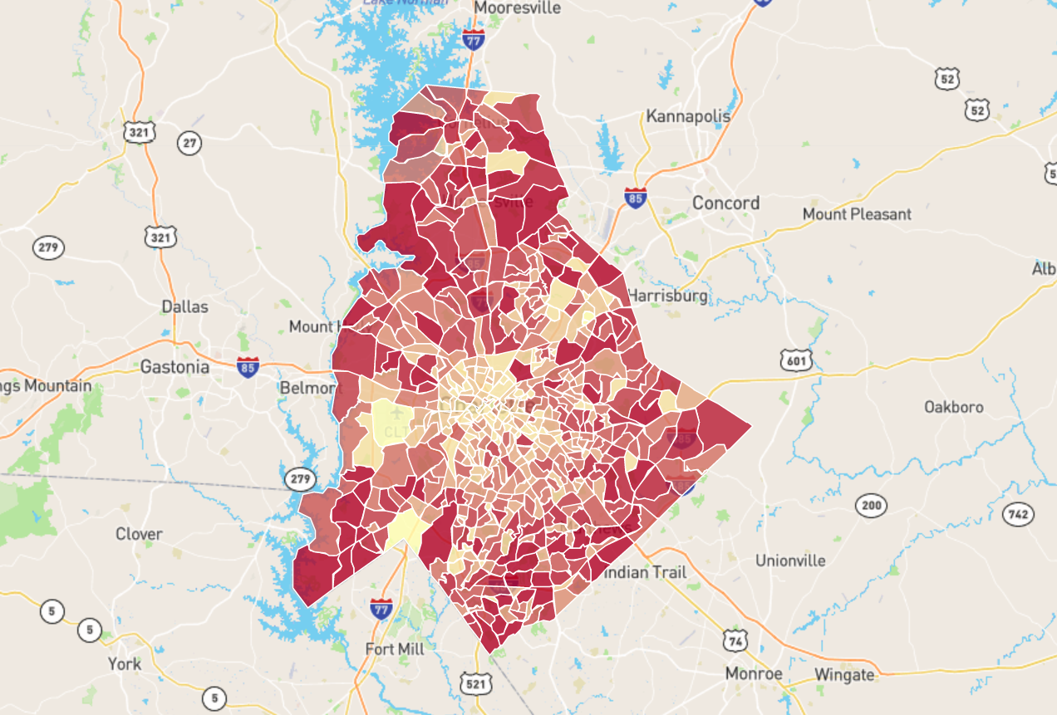
Visualization 1: Family Population Density by Zip Code
The Family Population Density by Zip Code visualization used a geojson file to outline the borders of each zip code in the greater Charlotte metropolitan area. A heatmap was then overlayed to reflect areas with greater population density by linking with a choropleth javascript file. Popups were then applied to reflect the exact number of families in that area as per the census information which the user can access by clicking on a zip code. The visualization also includes zoom functionality.
This visualization reflects the population density of a particular zip code in the greater Charlotte metropolitan area. The color coding reflects that central Charlotte is less densely populated as the outer regions and immediate suburbs which contain more family households.

Slide 6
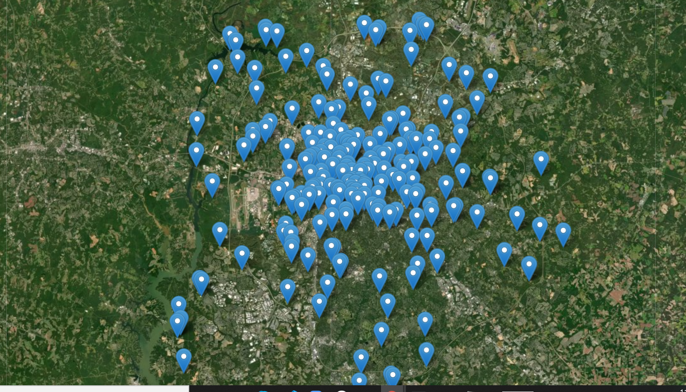
Visualization 2: Charlotte Parks: Satellite View
The Charlotte Parks: Satellite View pulled data from the Flask API database linkages to place markers on the exact park locations. The user can interact with the visualization by clicking on a marker which will then display the park name. This visualization also includes zoom functionality.
The Satellite Visualization reflects that park quantity is greatest in the central Charlotte metropolitan zip codes. As population is more concentrated in the outer regions, residents are required to travel to the central city in order to take advantage of park offerings.

Slide 7
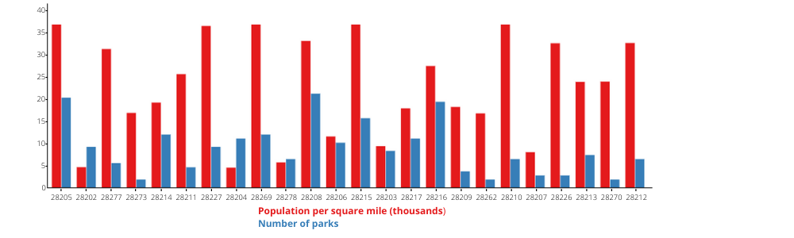
Visualization 3: Park Quantity vs. Population Density
The Park Quantity vs. Population Density visualization is a bar chart which was created using the javascript D3 library. The code first grouped the data by zip code and then pulled out both the population density and park quantity. The outcome of this bar chart reinforced that zip codes with high population density do not have access to as many green spaces. Additionally, it highlighted that areas where population is less dense and there are a higher number of parks tend to be in more affluent zip codes.
The bar chart reinforces that zip codes with the greatest population density do not have access to as many parks. Interestingly, the zip codes with low population density but relatively high numbers of community parks are located in more affluent areas such as zip code such as around South Park.

Slide 8
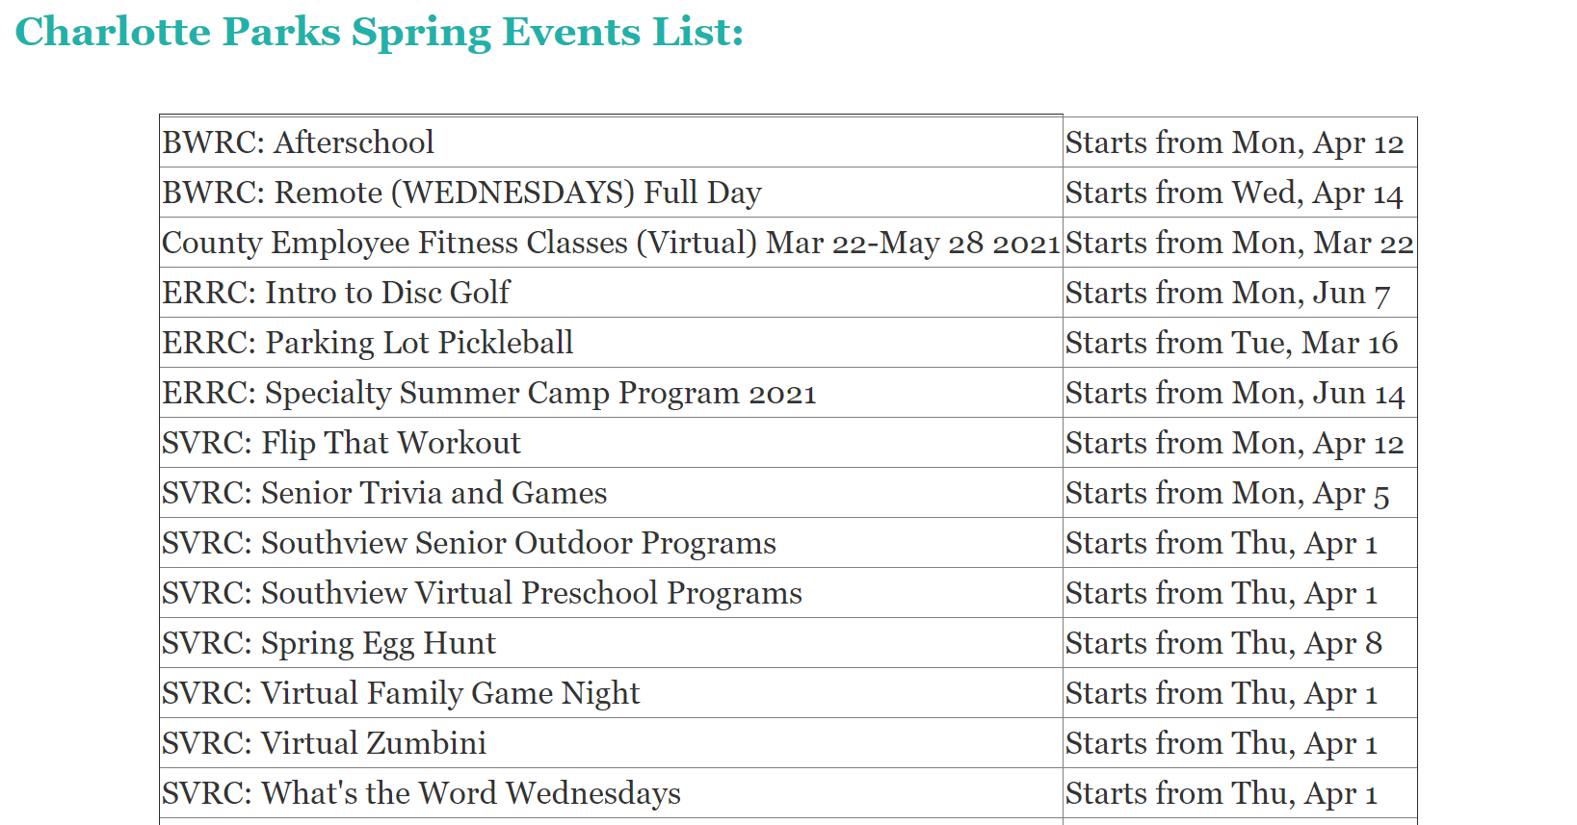
Visualization 4: Web Scraping
The Charlotte Parks Spring Event List leveraged web scraping code from the Mecklenburg County Parks and Recreation website. The scrape code was built out in Python and pointed to the website's activities page. From this page, the activity name and date of the activity or in the event the activity recurred, the starting date of the activity. The activity list was then connected to an SQL database and then converted into an html table. This table was then coded into the master html.

